Slide 1
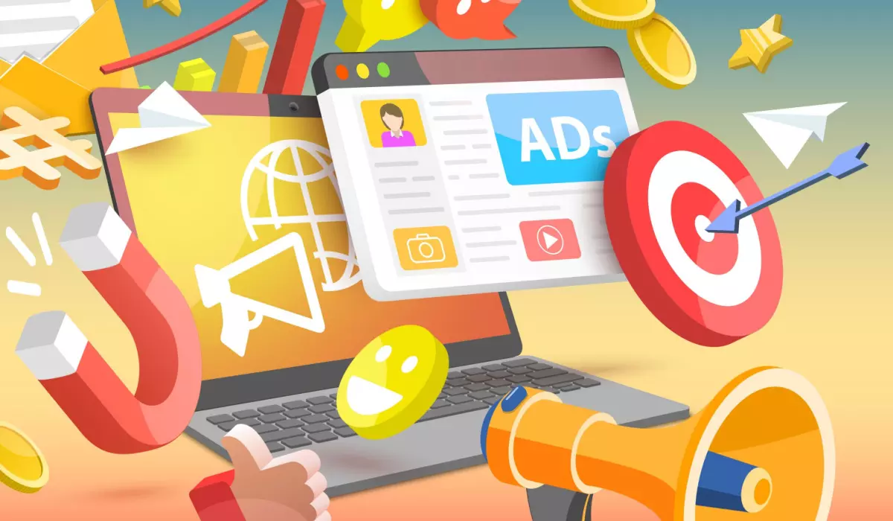
Campaign Pulse: Crafting Campaigns from Social Media Insights

Slide 2
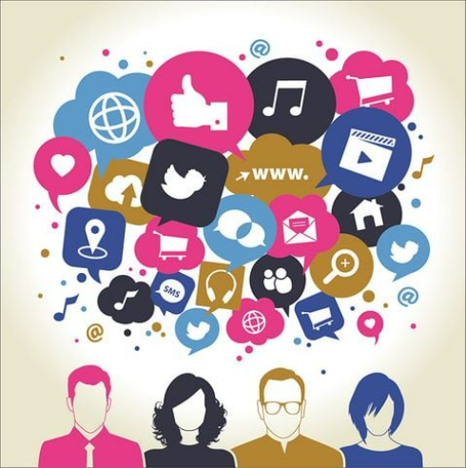
Project Objectives
Understand the images and text in the social platforms like Twitter and Instagram that can add value to the overall insights and help to analyze:-
Product categories
Compare brands based on social media responses
Extract themes and topics from the images and text
Final Product Goals
To decipher the hidden meaning from text/image, and to analyze the data extracted.
To find an approach to uncover patterns.
To build interactive cluster analysis.
Using analysis to drive the product into the market with concrete strategies.

Slide 3
Acceptance Criteria
We want to use a certain hashtag, parameter
So that we can design a marketing campaign
The acceptance criteria would be as follows:-
Given, as a marketing team when the client applies a particular hashtag on Twitter/Instagram there would be a set of images and text scraped. We would then analyze the image - text on the image, any logo, emotions/expressions. Using this data, the final output can be used to determine the target audience, the perspective towards the product and drive the marketing campaign based on that.

Slide 4
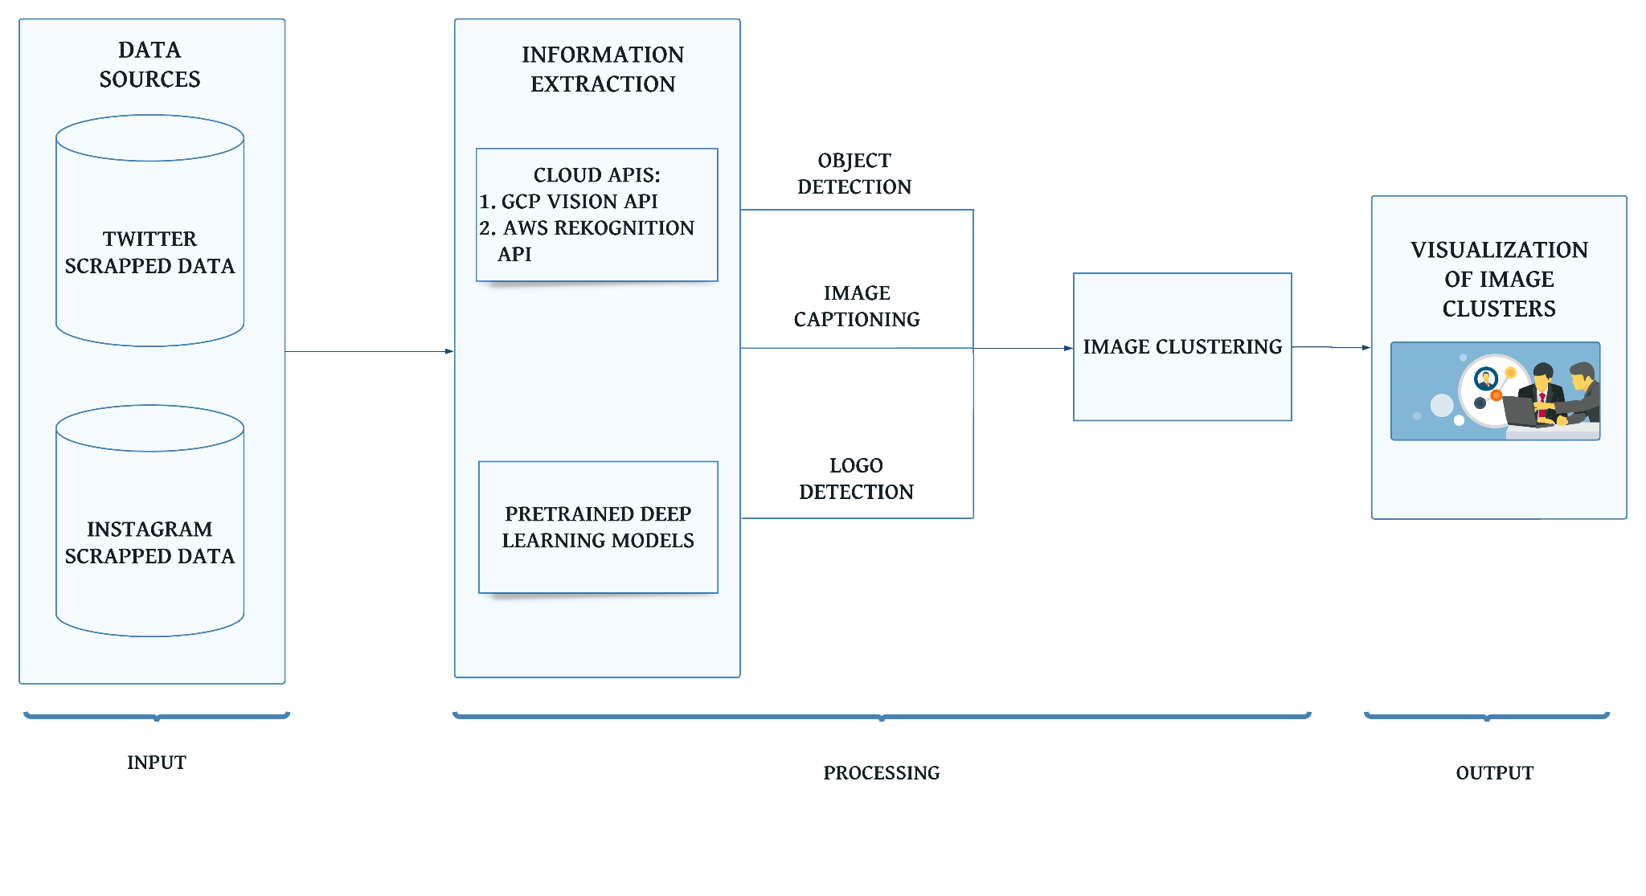
Technology & Tools (Architecture Diagram)

Slide 5
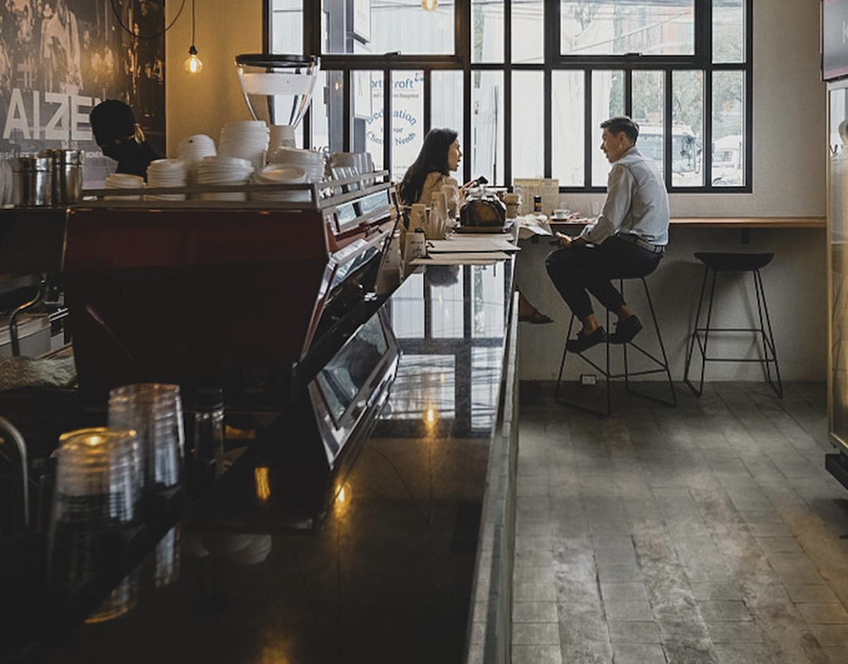
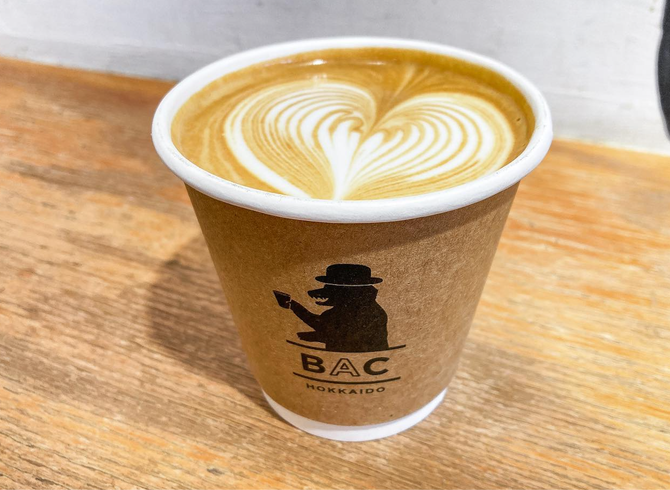
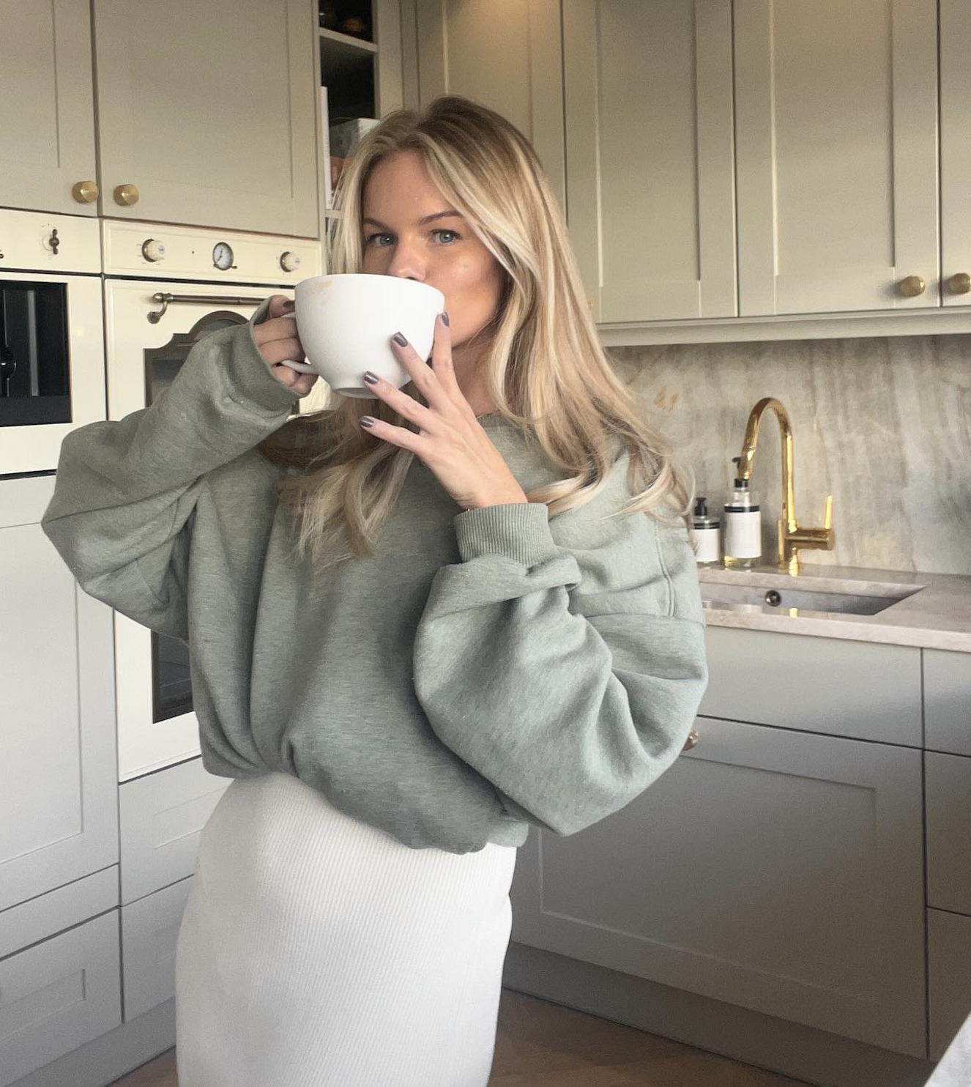
STEP 1: SOCIAL MEDIA SCRAPING
Developed methodology to scrape images using hashtag from Twitter and Instagram
Created database with 1,000+ images related to our chosen product (coffee)
Example: Images Scraped from #CoffeeTime Hashtag

Slide 6
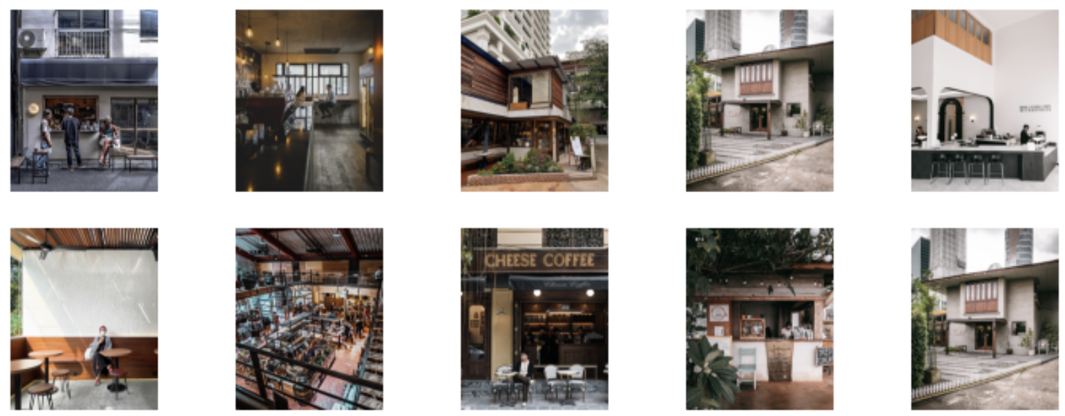
STEP 2: CLUSTER IMAGES
Utilized deep learning models to cluster images based on features
Conducted semi-supervised learning to understand clusters’ “themes”
Example: One cluster from our model centered on coffee shop exteriors

Slide 7
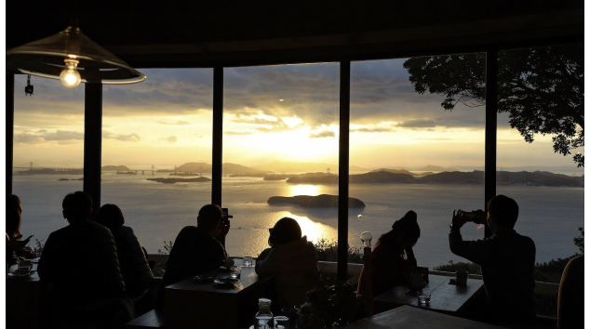
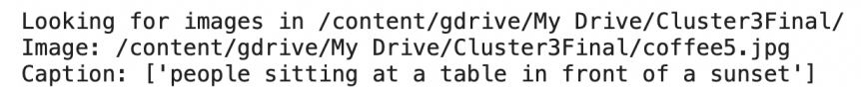
STEP 3: CAPTION IMAGES
After clustering based on image features, we created process to generate automated captions
Example: Automated Caption from Scraped Image

Slide 8
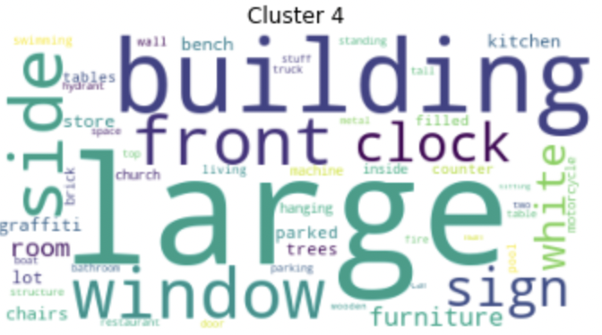
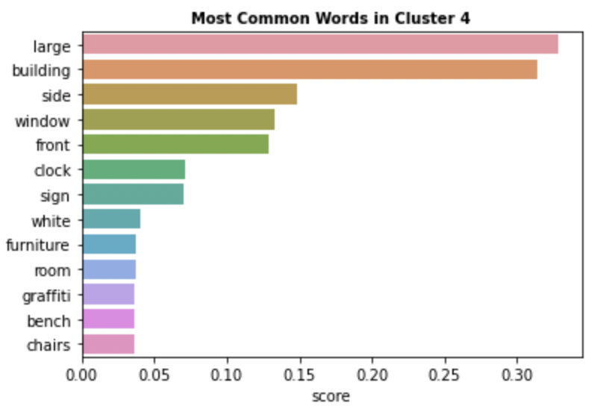
STEP 4: TEXT ANALYSIS
Used “TF/IDF” metric to understand importance of words within clusters
Made graphs and Word Clouds to visualize findings
Example: Visualizing Key Terms from one Cluster

Slide 9
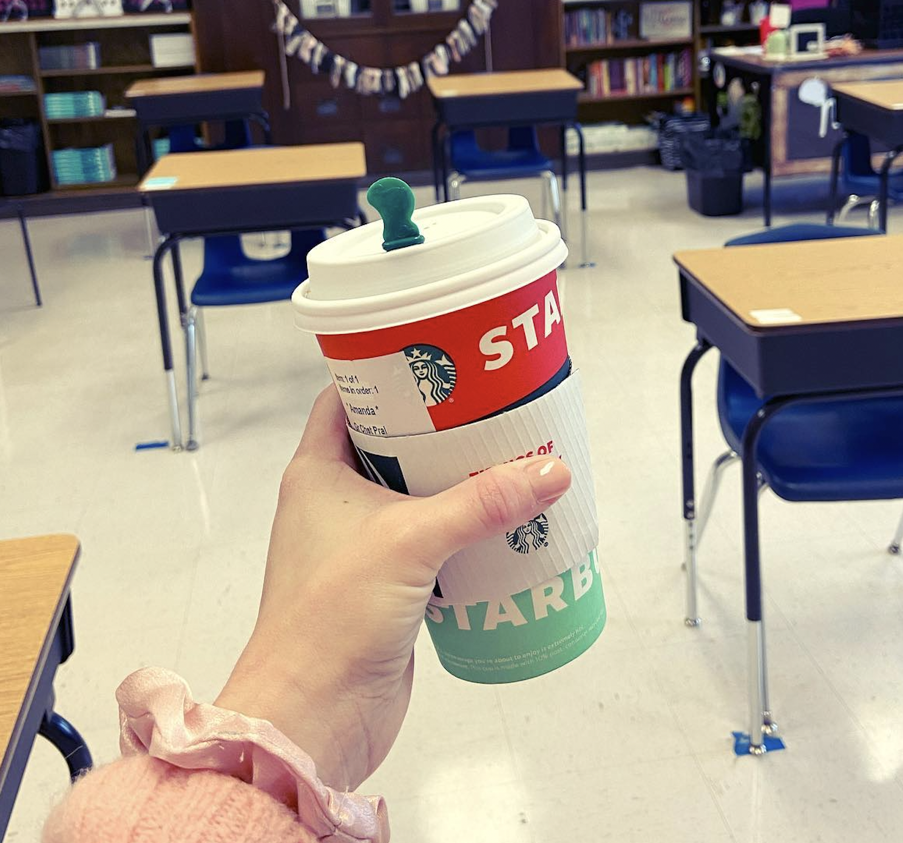
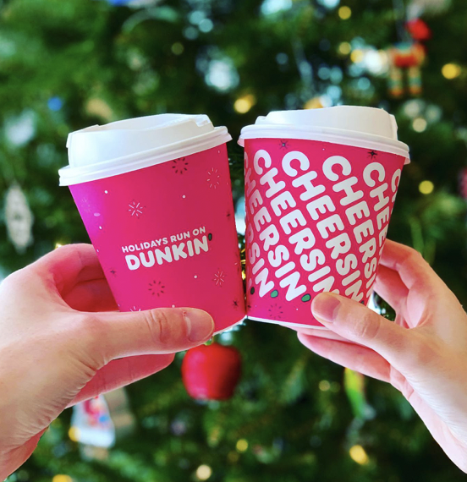
STEP 5: USE CASE
Can use hashtags to design social media marketing campaigns from extracted insights (image and text analysis)
Can run brands hashtags through this process for comparison of brand effectiveness (eg: Starbucks vs Dunkin)
#StarbucksHolidayCup #DunkinHolidayCup

